Slide 1

Abroad Squad + Chris
Bonjour !
Patrick Zambri, Bradford Harris, Marisa Proscia, Chris Siena, Jacob Levinson

Slide 2
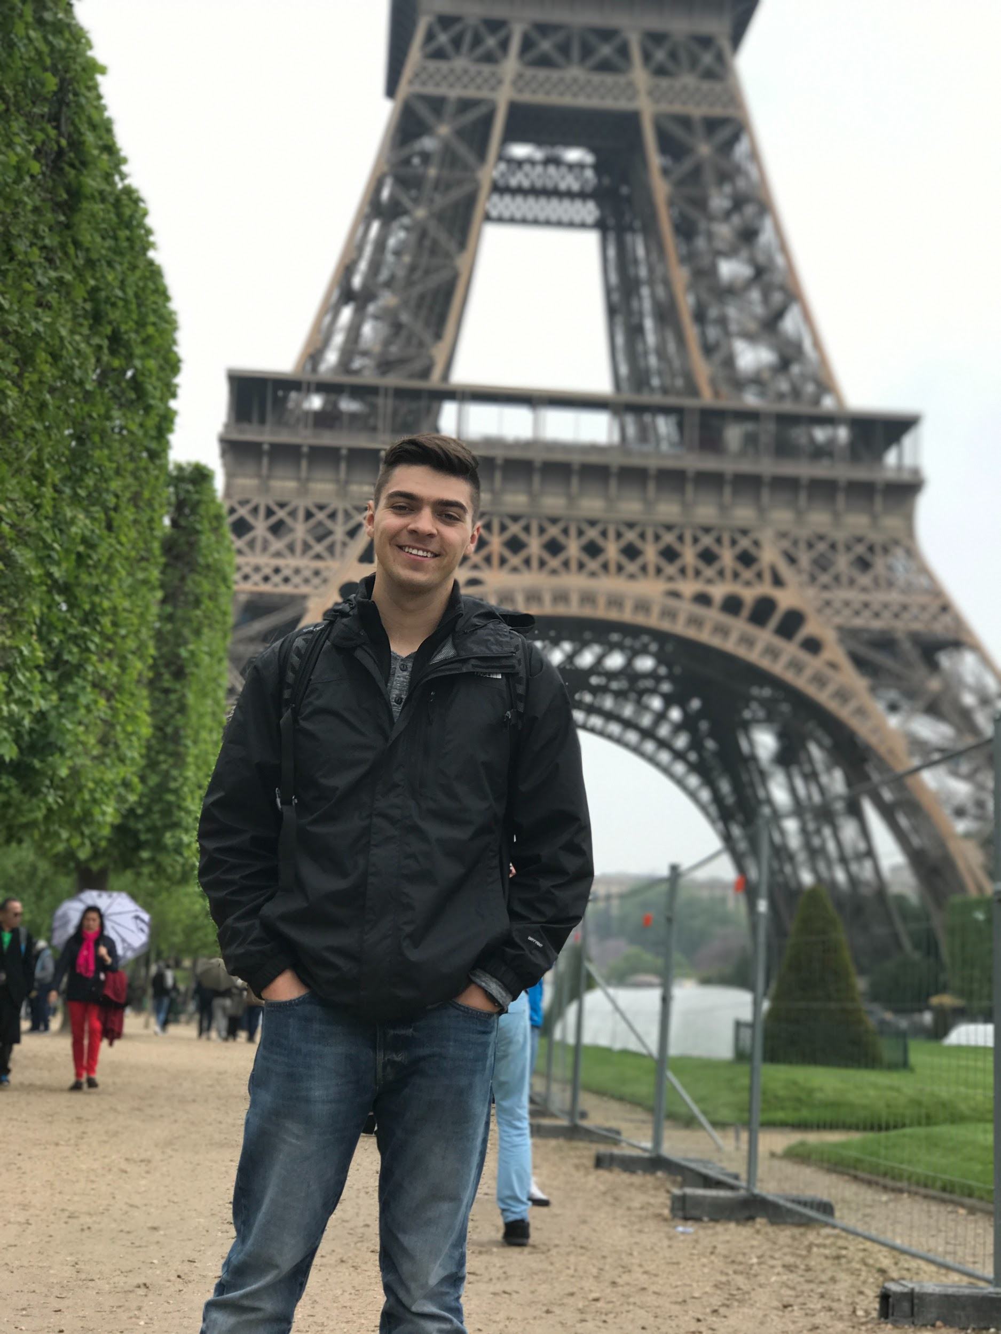

Team Pictures

Slide 3
Schedule
Week | Requirements | Development | Testing | Members
5 | Begin work on basic functionality of website and features Homework 3 due | Finalize website UI mockups. Compare mockups to client specifications. |  | Marisa, Jacob, Chris Brad All
6 | Final Project Plan & UML Diagrams | Ensure team is staying on track with plan while providing realistic expectations to the client and constantly updating Project Plan. Finalize Project Plan based on updates and instructor feedback. Finalize UML Diagrams. Continue work on website functionality and features. |  | Brad Patrick Marisa, Jacob, Chris
7 | Database Design Draft Due | Create database design draft. Implement database design standards to draft. |  | All
8 | Initial Peer Reviews Due | Individually Complete first round Peer Reviews. Revisit database architecture and prepare prototype for production. | Test overall website functionality. | All Chris, Marisa, Jacob
9 | IT Requirements Draft Due | Revisit database architecture and prepare prototype for production. Team meeting to finish draft of IT requirements & network design. |  | Chris, Marisa, Jacob Brad,Patrick
10 | Complete Database Prototype Homework 4 Due | Complete Database Prototype. Ensure work is being completed on time in order to be ready for the demo in week 11. |  | Chris, Marisa, Jacob Brad All
11 | Demo of Prototype prepared | Provide a demo of a functioning prototype website. |  | All

Slide 4
Project Status
 | Schedule | We are adhering to our development schedule.
 | Technical | We fixed our SSH problem, and have been able to connect to our sever. We are currently designing our database.
 | Resource | We currently have outstanding client questions.
 | Other | N/A

Slide 5
Project Progress
Accomplishments
Revamp Homework 2
ER Diagram
ER Documentation
IT Requirements
Activities being worked
Homework 4
Database Design
Continued development of UI
Roadblocks
Nothing currently

Slide 6
Scope of Project
What it is | What it is not
A website and mobile application | A desktop application

Slide 7
Project Risks
Risk | Score | Mitigation
Time .. Nothing new | High | Keep working.

Slide 8
Project issues
Issue | Owner | Action Plan | Checkpoint Date
Nothing Currently

Slide 9
Lessons Learned
Lessons Learned | Corrective Action / Recommendation
Gathering Client Requirements is the most important step in the development process | Ensure all clients needs are going to be satisfied by the system design by asking questions before and during the development process.
Always ask for help | It is great to work out a solution on your own, but in some scenarios it is best to reach out to others for assistance, versus spending too much time on something.

Slide 10
UI Wireframes

Slide 11
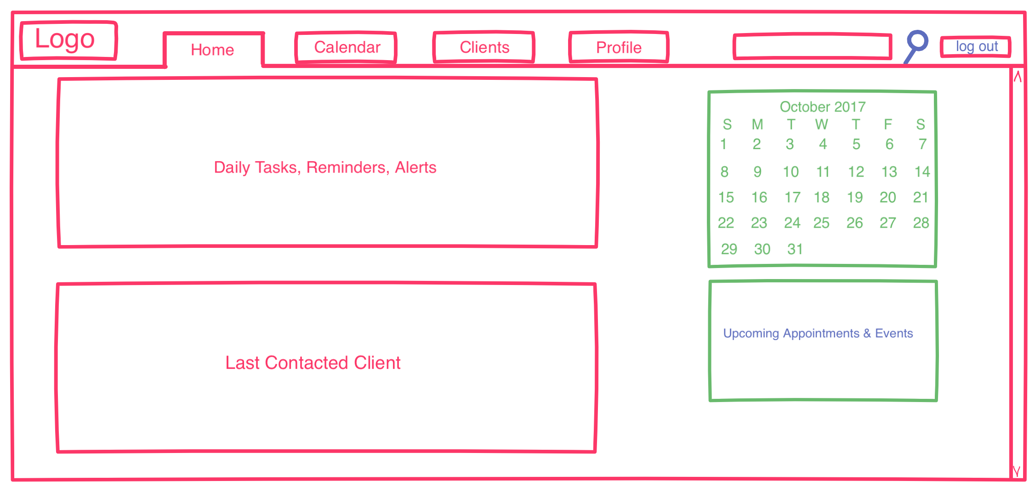
Homepage - Desktop

Slide 12
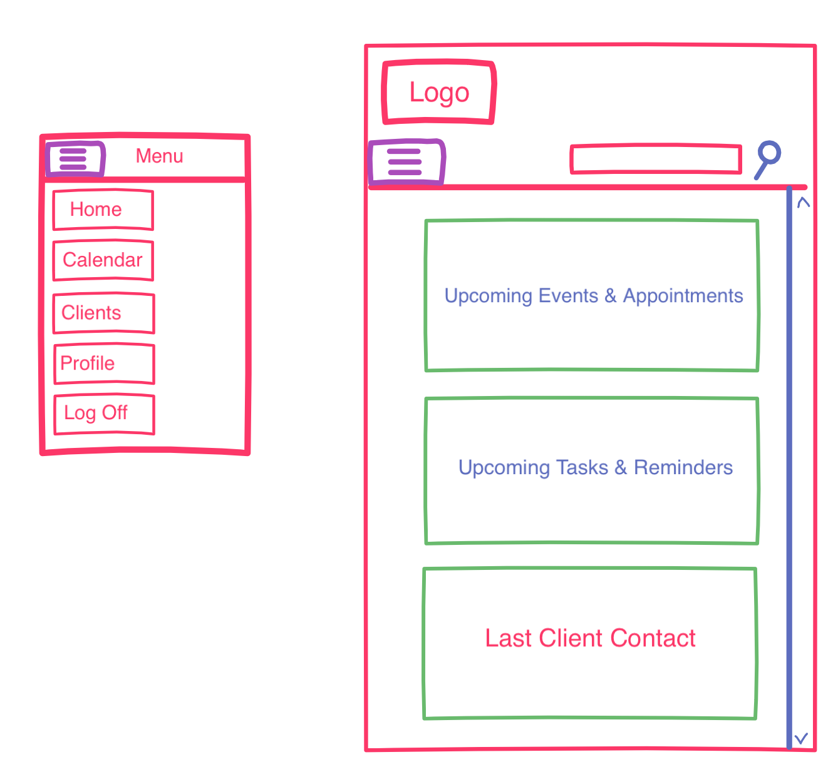
Homepage - Mobile

Slide 13
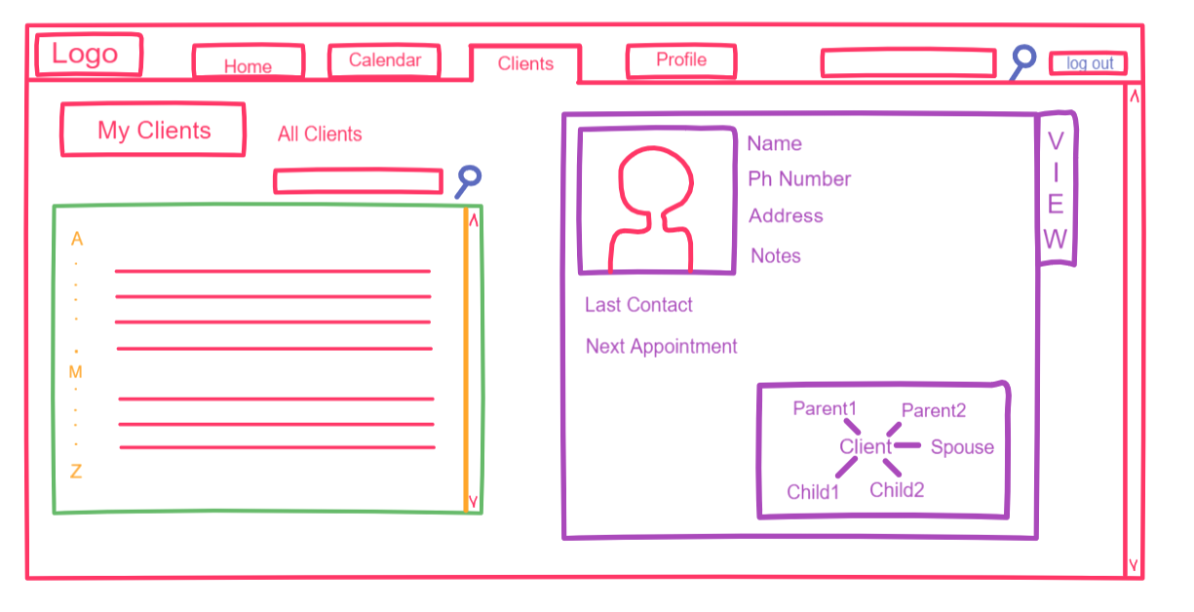
Family Tree

